Slide 1
Model Risk May 10, 2017

Slide 4
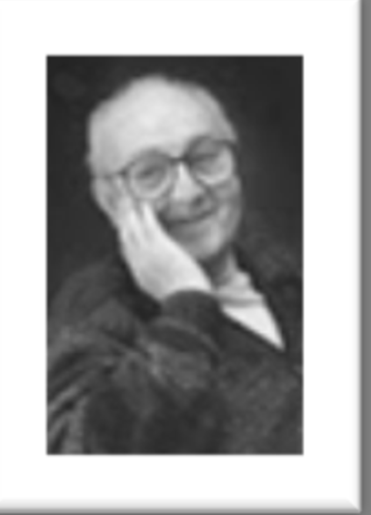



Slide 6
From Dani Rodrik, Economics Rules
Models are simplifications designed to show how specific mechanisms work by isolating them from other, confounding effects.
Economic uses a multiplicity of models tailored to different settings

Slide 7


Slide 8
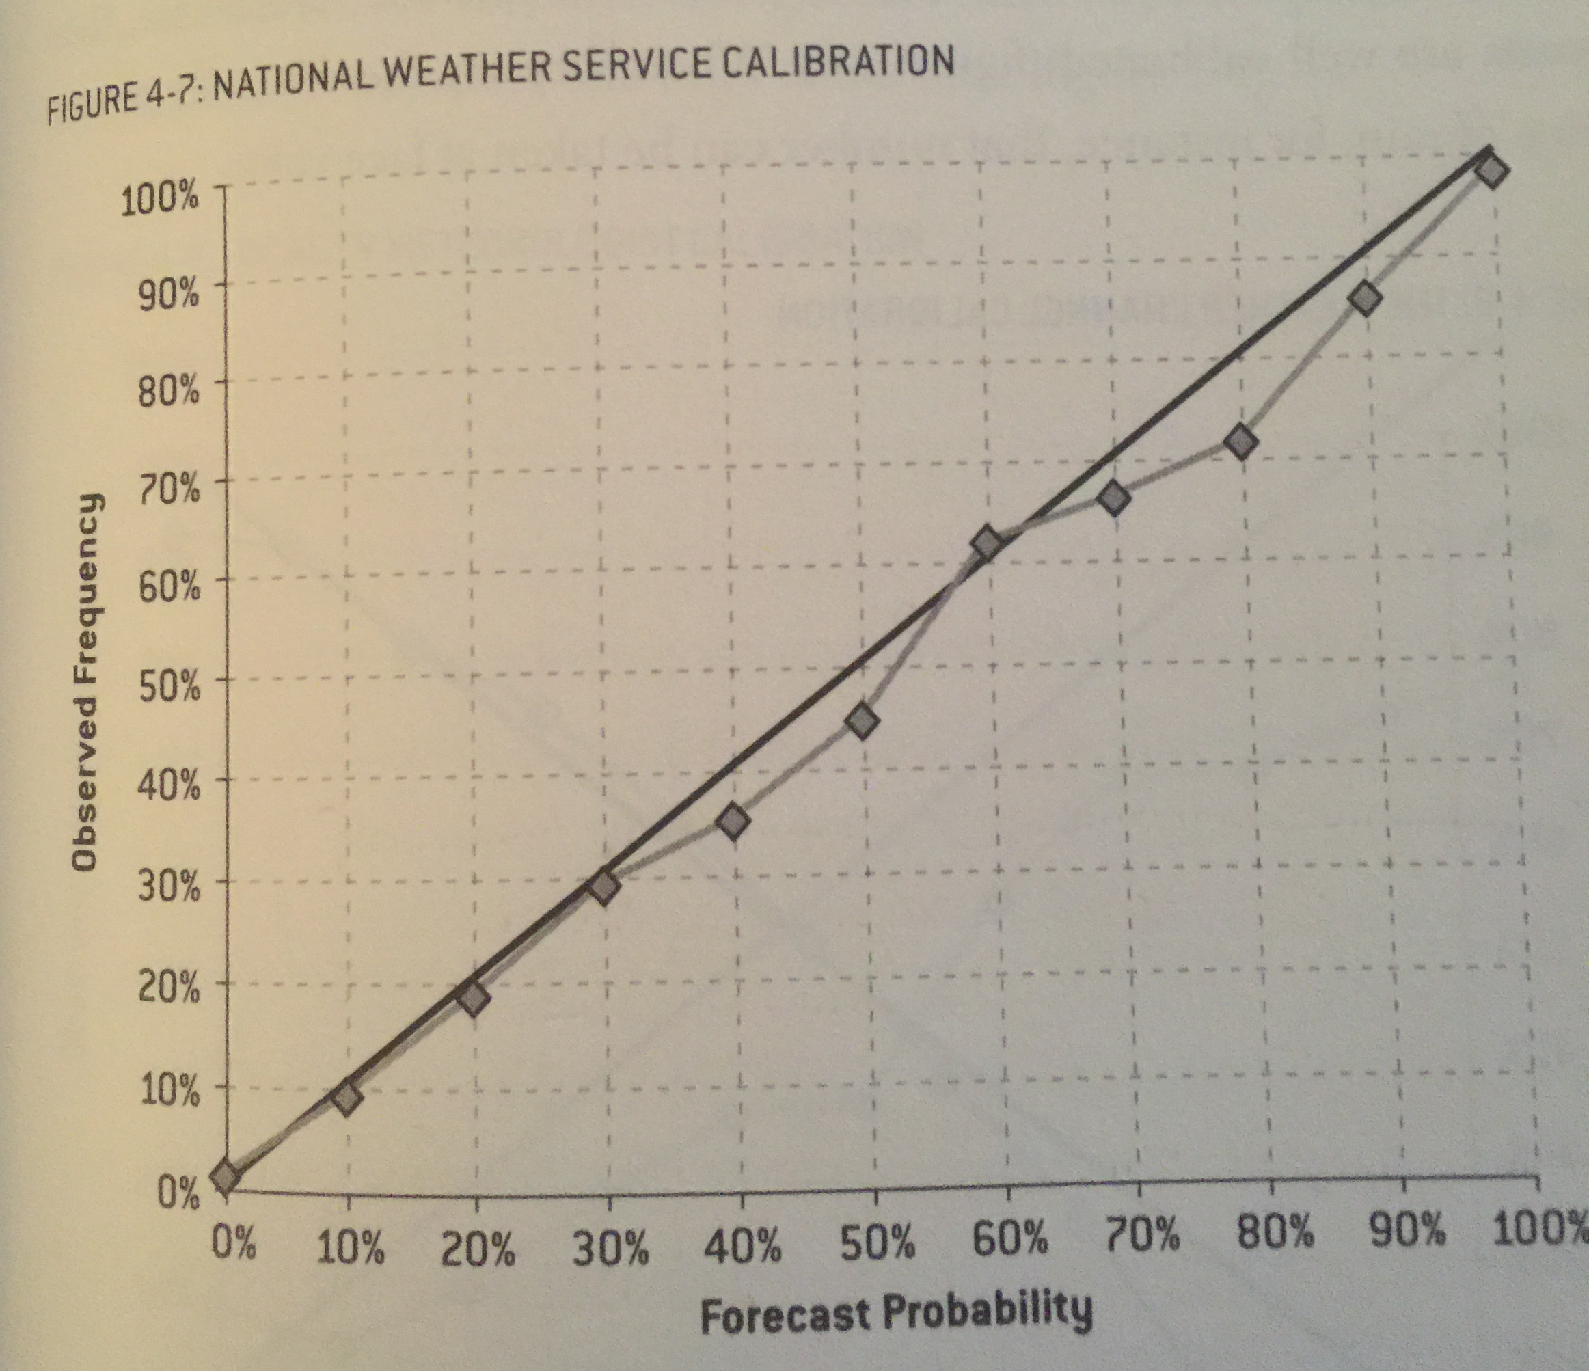

Slide 9


Slide 10


Slide 12
Controlling risk
The principal tool for controlling risk should be a disciplined use of stop-loss limits
This can only as good as management discipline in taking stop-loss limits seriously – extending new capital only when the trader can make a good case for a strategy yielding results if given more time
Making sure that current position is properly marked-to-market at least daily is critical – you don’t want to be dealing with a trader who knows he’s through his stop-loss limit when you don’t
This also requires tools for managing the liquidation risk of positions that need to be closed-out because of stop-loss limits

Slide 13
Controlling risk
Key principles for stop-loss limits
Careful and continuous tracking of market prices of existing positions
Sensible choices of limit size relative to trader expertise and trading strategy
Good procedures for review of requests to exceed limits
Analysis of reasons for large losses and large gains
Financing plans

Slide 15
Model risk evaluation and control
Scope of model review and control
Roles and responsibilities
Model verification
Model validation
Continuous review
Periodic review

Slide 16
Model Risk
Liquid positions
Models may be used for interpolation between liquid price quotes
Models will be used for calculation of the impact of market changes on positions in the VaR and stress test calculations
These model uses are robust and easy to test, since they can constantly be checked against actual liquid market quotes

Slide 17
Model Risk
Illiquid positions
Model becomes critical and hard to validate
Must employ as much liquid market data in the model as possible to avoid unnecessary staleness of MTM
Must clearly identify illiquid inputs and estimate liquidation risk through conservative assumptions (relative to net exposure to illiquid inputs)
Model Greeks are only useful in representing sensitivities to liquid market data; they cannot be used in identifying the potential cost of being wrong about the illiquid inputs (since your risk on the illiquid inputs is not to small hedgable changes)

Slide 18
Using liquid proxies to estimate illiquid instrument risk
Use liquid proxies to represent these trades in computations designed for the firm’s liquid positions, such as MTM, VaR and stress tests
Avoids stale MTMs
Measures risk concentrations and encourages diversification
Every model is a potential liquid proxy representation; every liquid proxy representation is a model subject to error
Model difference between actual product and liquid proxy to create conservative valuation assumptions
Modeling of differences must go all the way to final payout and must reflect the possibility that the model used for pricing and trading the product may be wrong
Modeling should be by Monte Carlo simulation to reflect a full range of possible outcomes
The liquid proxy is just a form of representation; it is not intended to dictate hedging action to the trading desk
Traders who believe that they have better hedging strategies should be given sufficient limit room to act on these (plausible) beliefs and should reap the resulting gains (and losses)
Notes:
18
18

Slide 19
Calculation of the Liquidation Margin for Position of Illiquid Size
Illiquidity of position size must be judged relative to normal trading volume
Can estimate liquidation risk by VaR-like price moves over a time period in which orderly liquidation can take place
Alternatively, can model the market impact of large volume
In either case, this is an adjustment for added cost of liquidation beyond the normal liquidation costs of a smaller position

Slide 20
Derman on estimating illiquid instrument risk
“It’s never clear what profit and loss will result from hedging a derivative security to its expiration. Markets will move in unexpected ways, sometimes intensifying transactions costs and often dismantling what seemed a reasonable hedging strategy. These effects are rarely captured by the conventional models used in front-office valuation systems.”
“Therefore, for illiquid positions, it is important to estimate the adjustments to conventional marked values that can occur as a result of long-term hedging. One should build Monte Carlo models that simulate both underlyer behavior and a trader’s hedging strategy to create distributions of the resultant profit or loss of the whole portfolio. These distributions can be used to determine a realistic adjustment to the trading desk’s conventional marks that can be withheld until the trade is unwound and their realized profit or loss determined…Monte Carlo analysis provides a good sense of the variation in portfolio value that will be exhibited over the life of the trade due to transactions costs, hedging error and model risk. Ultimately, such analyses should be part of the desk’s own front-office valuation system.”

Slide 21
Options position risk
Because of the wide variety of options contract specifications, there needs to be some underlying principle for integrating risk reporting
Puts and calls
Variety of dates that options expire
Variety of strikes at which options can be exercised
The Black-Scholes model is the key to managing and reporting options position risk
It is used to interpolate market prices for all options from reported prices for a handful of options
It is used to identify a few key variables that impact the prices of all options
It is used to measure the change in options prices to changes in these key variables
There are known flaws in the model but risk managers and traders have developed procedures for dealing with them

Slide 22
Flaws in the Black-Scholes formula
Trivial flaws
BS assumes that assets prices are log-normally distributed when in fact they have fat tails
Any distribution can be accommodated by a slightly more complex model and closely approximated by BS using different volatilities at different strike levels
BS assumes a constant risk-free interest rate when in fact rates vary by maturity date
Variability of rates can be accommodated by basing BS on the price of a forward contract on the asset
BS assumes that hedging will take place continuously
Experience and simulations show that reasonably frequent hedging is very nearly as effective as continuous hedging

Slide 23
Flaws in the Black-Scholes formula
Significant flaws concerning hedging
BS assumes that hedging can take place without transaction costs
Large options trading desks only need to hedge net exposures which holds transaction costs down to a very small part of overall trading costs
Other users of options can count on large options trading desks to eliminate pricing discrepancies
BS assumes that asset prices follow a smooth path with no sudden jumps
Risk reports need to be developed to show exposure to price jumps
By engaging in both buying and selling options, this exposure can be kept under control

Slide 24
Flaws in the Black-Scholes formula
Significant flaws concerning volatility
BS assumes that volatility is known in advance
Risk reports need to be developed to show exposure to volatility uncertainty
By engaging in both buying and selling options, this exposure can be kept under control
BS assumes that volatility is constant when in fact volatility varies by time period and price level
Risk reports on volatility exposure need to show details of exposure bucketed by tenor and strike

Slide 25
Option position reporting using the Black-Scholes Greeks
The “Greeks” are the sensitivities of an option portfolio based on changes to the inputs to the BS formula
Sensitivities that need to be consolidated with non-option positions
Delta is the sensitivity to a change in asset price
Delta is used to consolidate option exposures into position reports for the asset
Very important in making sure that undiversifiable exposure to stock indices and government bond price levels is captured
Rho is the sensitivity to changes in interest rates
Rho is used to consolidate option exposures into interest rate position reports
Two interest rate positions may be needed (e.g, Dollars and Euros on an FX option)
Sensitivities that are unique to options
Vega is the sensitivity to changes in volatility
Exposure to a parallel shift in volatility is the most important risk exposure that is unique to options
Theta is sensitivity to changes in time to expiry
Theta reports show exposure to time decay – getting closer to expiration of the option with no further price moves
Gamma is the sensitivity of delta to a change in asset prices
Gamma reports are a first approximation to exposure to jumps in asset prices

Slide 26
Option position reporting that goes beyond the Greeks
Price-volatility matrix reporting
Shows the exposure of an options book that is currently delta-hedge (hedged against small changes in asset prices) to different combinations of large changes in asset price and volatility
Very important for getting a complete picture of exposure to price jumps (look at Table 11.6 to see a portfolio with 0 gamma and 0 vega that still has exposure to price jumps)
Vega bucket reporting
The principal exposure to volatility changes is picked up by the vega measure
Basis risks between options of different maturities requires bucketing vega by time to expiry
Basis risks between options of different strikes requires bucketing vega by strike

Slide 27
How do we know that these fixes to BSM can be used to control risk?
Historical experience shows there have been no major blow-ups due to market-making in reasonably liquid vanilla options
Simulations can be performed to show that while risk has not been eliminated it has been reduced to controllable levels (see section 11.3 for details)
Adequate risk control requires frequent (but not continuous) trading in a liquid underlying asset and infrequent trading in a less liquid (but somewhat liquid) set of options with strike and tenor characteristics that reasonably approximate the options being hedged

Slide 28
Estimating Illiquid Instrument Risk
Model difference between actual product and liquid proxy to create conservative valuation assumptions
Modeling of differences must go all the way to final payout and must reflect the possibility that the model used for pricing and trading the product may be wrong
Modeling should be by Monte Carlo simulation to reflect a full range of possible outcomes
Derman recommends a full simulation that includes both underlying behavior and trader hedging strategy. This represents an ideal that may sometimes be difficult to achieve in practice.
Simulation by assuming infrequent rehedging can make use of more public information and can be easier to implement, but at a cost of greater conservatism, since the full range of trader hedging strategies will not be captured.

Slide 29
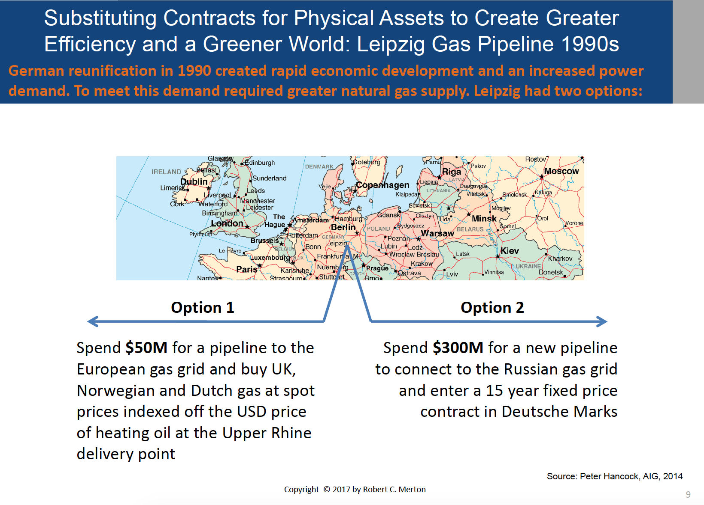

Slide 30
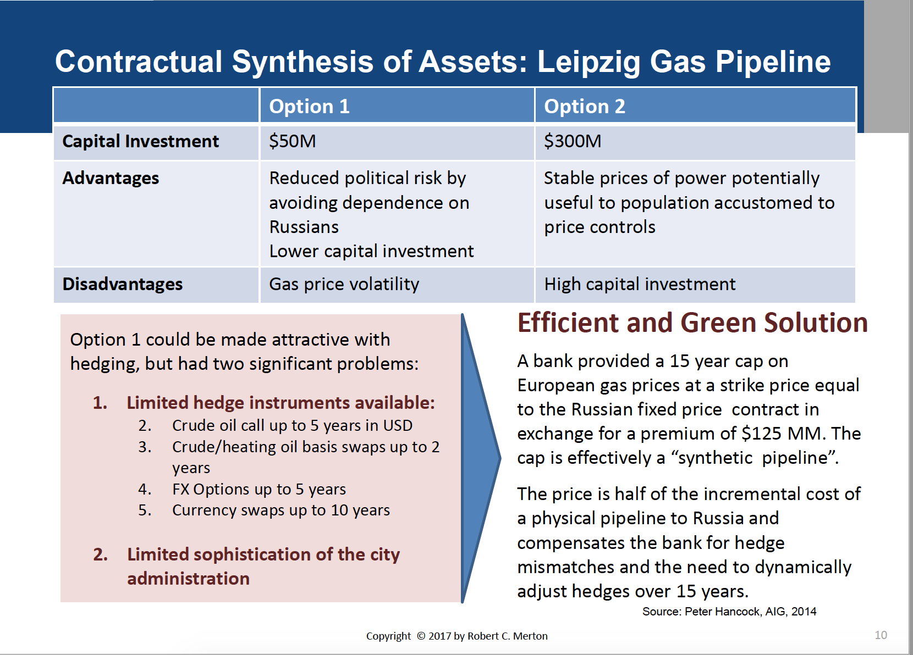

Slide 31
Liquid proxy example: Illiquid swap [Section 10.2.2]
Suppose there is a liquid two-way market in a certain currency’s swaps out to 7 years, but only a one-way market to pay 10 year fixed
A full simulation of a hedging strategy could be quite complex.
An alternative is to use a 7-year swap as the liquid proxy for the 10-year swap and conservatively estimate the illiquid piece as the cost of a one-time trade, 3 years from now, to reverse a 4-year swap and put on a 7-year swap (this is called a “stack-and-roll”)
Every day for which public liquid quotes of 4 and 7 year swap rates are available contributes an independent data point for estimating this cost
If the liquid market only extends to 5 years, you would need two trades: a 2 year swap into a 5 year swap in 3 years, followed by a 3 year swap into a 5 year swap after 2 more years
This approach generalizes to illiquid maturity options, though a range of strikes needs to be used to offset the impact of price changes prior to the one-time trade date and the full vol-surface (skew as well as time) needs to be considered

Slide 32
Liquid proxy example: barrier options
Suppose there is a one-way market for selling a down-and-out call option (a call option that has zero payoff if the asset price goes below a certain barrier any time during the life of the option)
A liquid proxy would be selling a European call option with the same strike and expiry date as the barrier option along with the purchase of European put options struck below the barrier
If the barrier is never struck, the puts expire worthless
Estimate the illiquid piece by the cost of reversing the European call and put positions at the time the barrier is hit, relative to a set of scenarios
Each scenario would specify the time the barrier is hit, the level of implied volatility at the time the barrier is hit, the volatility skew at the time the barrier is hit, and the slope of the forward price curve (the drift) at the time the barrier is hit
The representation by the liquid proxy allows correct representation in risk reports showing sensitivity to volatility level and volatility skew.
This is similar to Peter Carr’s approach (and gives the same results when volatility skew and drift are zero) but may utilize more expiry dates for the puts and explicitly simulates hedge slippage costs for varying volatility skew and drift
Notes:
32
32

Slide 33
Liquid proxy example: digital
Delta hedging of a digital option can be very dangerous, given the reality of discrete hedging. When the market is near the strike close to expiry, the delta hedge called for could result in very large losses
Full simulation of an optimal delta hedging strategy would be very difficult, depending on hard-to-determine information about the liquidity of large trades
An alternative is to use a call spread (selling a call at a strike lower than the digital’s strike and buying a call at a strike above the digital’s strike) as a proxy for selling a digital option
Estimate the illiquid piece as the difference between the potential payout on the digital and payout of the call spread
Hypothetical size of the call spread depends on how wide the strikes are set – the narrower the difference in strikes, the larger is the required size
The representation by the liquid proxy allows correct representation in risk reports showing sensitivity to volatility level and volatility skew.
The closer the strikes for the call spread, the smaller the potential loss on the illiquid piece.
Selection of the strikes for the call spread needs to be wide enough to make for liquid trade size and manageable deltas and gammas as the trade evolves
Risk of the illiquid piece can be easily estimated by Monte Carlo simulation. If you have a large book of digital options, negative impacts for some digitals on a given Monte Carlo path may be offset by positive impacts for some other digitals.
Notes:
33
33

Slide 34
Liquid proxy example: illiquid CDO tranche [Section 13.4]
Create a set of scenarios corresponding to different states of the economy, i.e., correlation is enforced through a principal component.
Use a model that fully incorporates exact modeling of cash flows in a given scenario.
Do a complete simulation to price each CDO tranche in each of these scenarios, assuming a fully diversified portfolio (i.e., no residual correlation beyond the principal component).
Probability weights can be assigned to scenarios based on observed prices of the underlying basket and observed prices of liquid CDO tranches (if available).
The model can be used to determine a good hedging portfolio, utilizing the underlying basket and liquid CDO tranches . This hedging portfolio can be used as a liquid proxy in risk reports.
Model risk can be measured by a Monte Carlo simulation of final payouts of the illiquid CDO tranche plus the hedging portfolio, including the impact of lack of full diversification.
Model risk must be judged by final payouts to maturity without any assumption of ability to sell a CDO.
A full simulation would include periodic recalculation of the hedging portfolio. A more conservative, but more easily computable, simulation would assume the initial hedge is held throughout.

Slide 35
Countering pro-cyclicality of regulatory capital requirements
Pro-cyclicality can be eliminated by the ability to sell liquid assets and by using a fixed target for non-liquid assets
There are two ways to deal with the pro-cyclical problem of higher demands for capital during economic downturns, when it is hardest to raise capital:
Positions can be liquidated
Adequate capital can be raised prior to the economic downturn
This implies that for liquid positions, capital can be tied to changes from current mark-to-market. Even though this will result in higher capital requirements during economic downturns, the ability to liquidate positions makes this manageable.
For illiquid positions, capital should not be tied to mark-to-market. In an economic downturn, capital will rise severely because losses on MTM cost capital on top of rising capital requirements tied to increased volatility. The option of position liquidation is not available to relieve this bind. [Sections 8.4.4 and 5.5.8.1]

Slide 36
Regulatory capital for illiquid positions
The alternative for illiquid positions is capital requirements tied to a fixed stress-level (e.g., default levels three times historical averages). This causes adequate capital to be raised when assets are first booked. When an economic downturn occurs, the capital drain of MTM losses is balanced by reduction of capital requirements, since current MTM is closer to the fixed stress-level.
Accounting standards should impact disclosure to shareholders and lenders, not regulatory capital standards
This is a natural outcome of the recommendation to tie required capital to fixed stress-level losses.
De-coupling regulatory capital requirements from earnings reporting would ease regulatory and investor concerns that building up reserves during good times is a way of manipulating the reporting of earnings volatility

Slide 37
Controlling risk
Similar issues exist for many risk management problems:
Control of trading risk through stop-loss limits and control of liquidation exposure
Control of counterparty credit risk through limits requiring settlement based on size of exposure and credit quality (e.g., downgrade provisions) and control of settlement exposure
Control of investment risk through limits on shortfall in funding of obligations (e.g., contingent immunization) and control of liquidation exposure

Slide 43
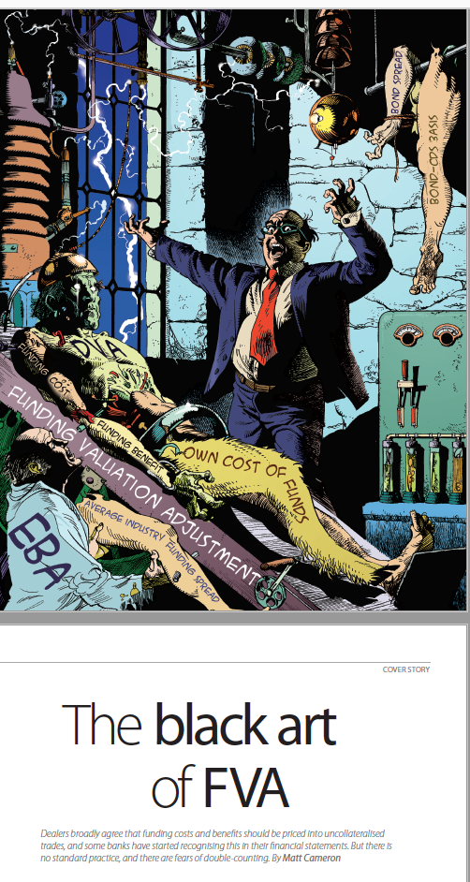


Slide 45
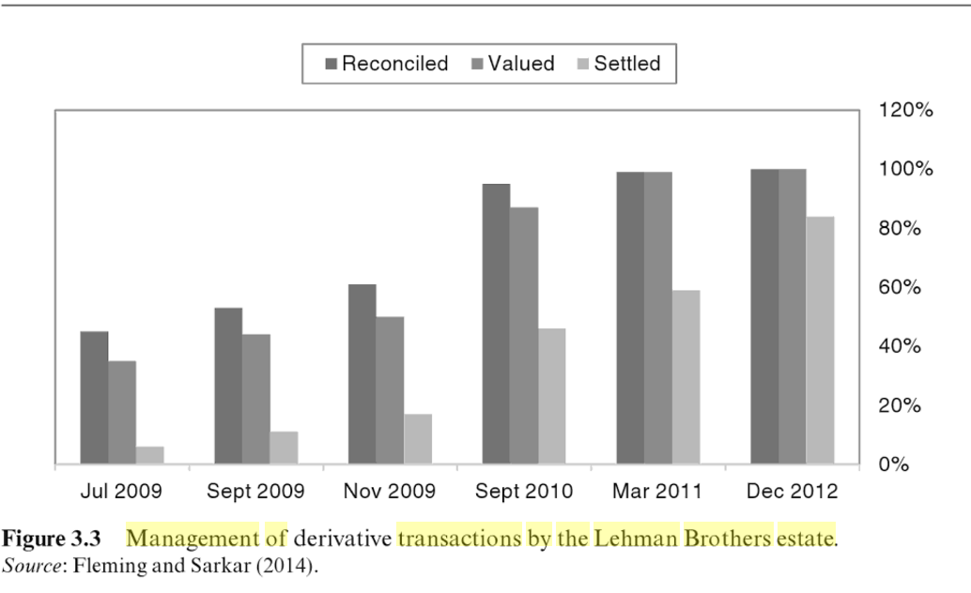
Lessons from Lehman

Slide 46


Slide 47
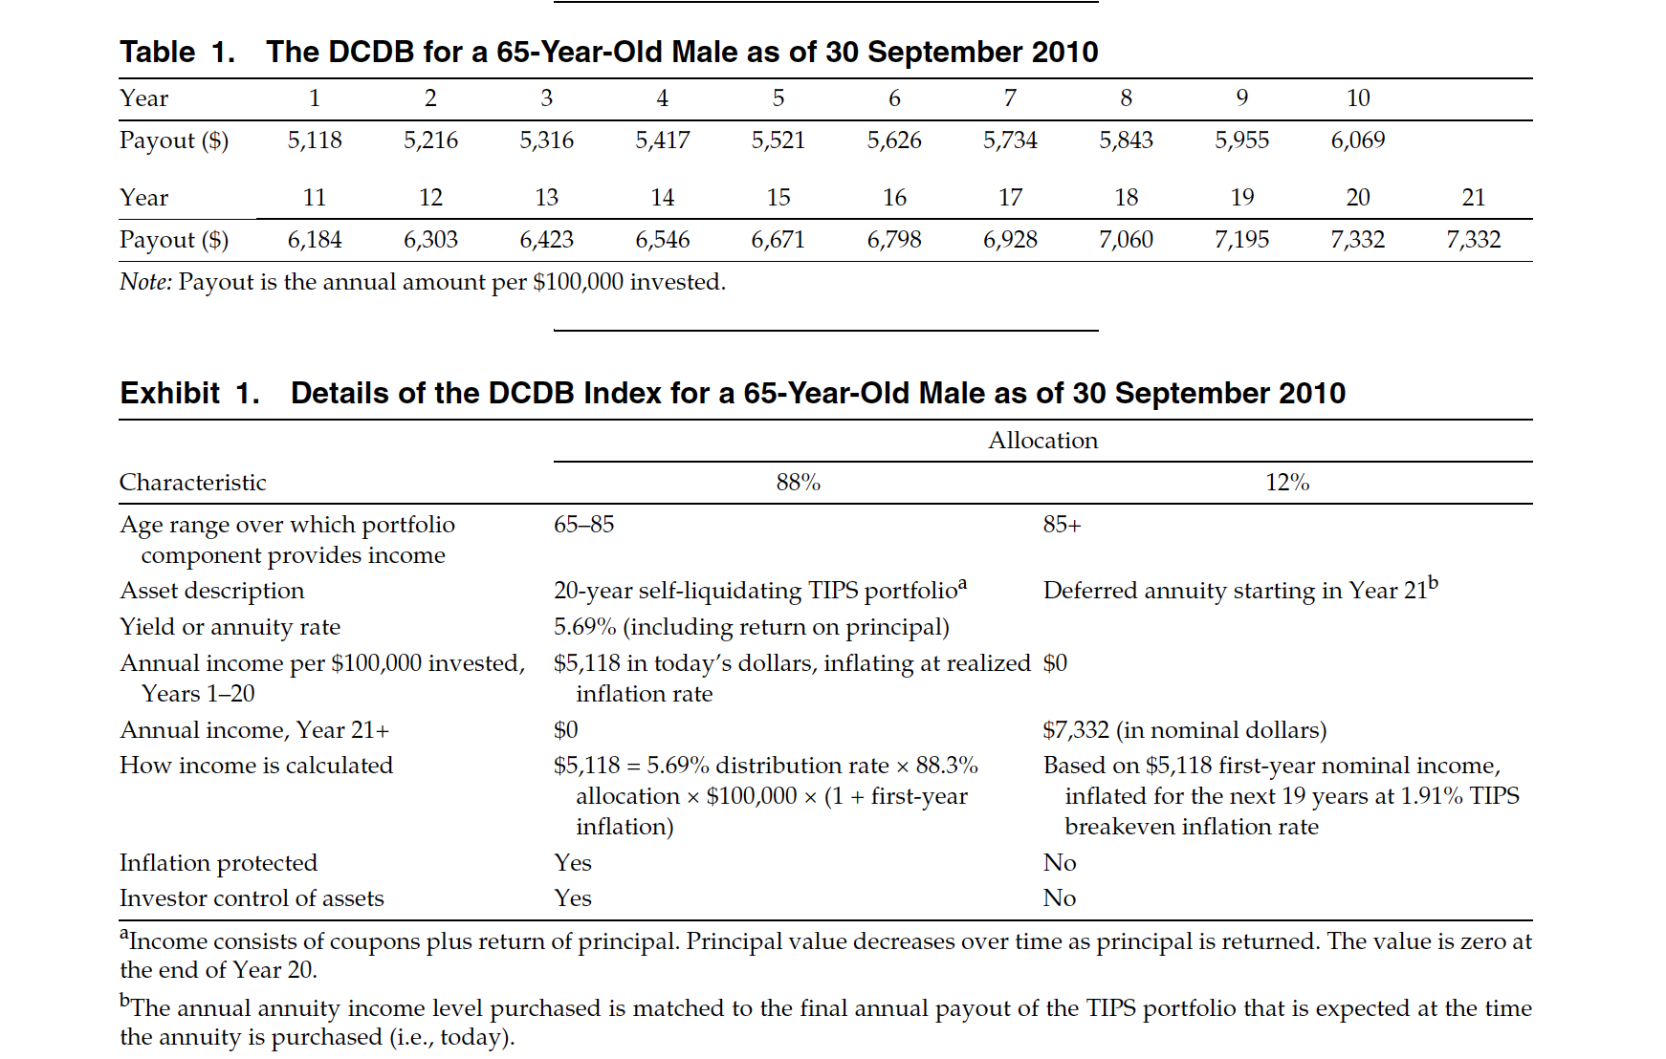

Slide 48
